Slide 1
VNA Programming with RsaToolbox For Qt 5
Nick Lalic
VNA Software Developer
Rohde & Schwarz America
May 2013

Slide 2
Contents
Introduction
Overview
Audience
Requirements
Software Tools
Installation
RsaToolbox Setup
Licensing
Part 1: Our First Application
Deleting Correction Data
Creating a new project
Project Components
Part 2: GUI Application
Additional References

Slide 3
Introduction
“What’s this tutorial about?”

Slide 4
Overview
This tutorial is an introduction to Vector Network Analyzer (VNA) automation applications using RsaToolbox for Qt 5
By the end of this tutorial you will be able to:
Use one of the provided project wizards to get a simple Qt 5 VNA application up and running
Connect to the instrument via Ethernet or GPIB
Connect using either the Rohde & Schwarz Instrument Bus (RSIB) or the National Instruments Virtual Instrumentation Software Architecture (NI-VISA).
Identify the instrument make, model options and properties
Control the instrument
Log instrument communication to a text file for troubleshooting
Save your applications long-term settings
Use RSA Create Installer to create a Windows installer

Slide 5
Audience
It is assumed that the reader has basic familiarity with:
Rohde & Schwarz Vector Network Analyzers (ZVA and/or ZNB)
C++
Object Oriented Programming
Developing applications with Graphical User Interfaces (GUIs)
Integrated Development Environments (IDEs) for GUI applications, such as Visual Studio
A basic awareness of the “Standard Commands for Programmable Instruments” (SCPI) protocol would be helpful, but is not required.
This tutorial is meant to be a gentle introduction. If at any point you need additional information, please consult the Additional References listed at the end. These are resources that I have personally found helpful, and are a good place to start for more information.

Slide 6
Requirements
The software used in this tutorial is either completely free or offered as a free version.
The following tools will be used:
Visual C++ 2010 (Express or better)
Qt 5.0 Framework, including the Qt Creator 2.6 Integrated Development Environment (IDE)
Windows Installer XML (WIX)
Optional: NI-VISA runtime library (for GPIB connections only)

Slide 7
Software
“How do I get started?”

Slide 8
Software Tools
A note on the selection of Qt: I started creating applications for VNA automation from scratch. As such I had a wide array of software platforms to choose from. My initial inclination was to use Visual Studio and either C# or C++. I wrote a few applications in both languages using Visual Studio 2010 and the .NET Framework. A large percentage of the applications I write are VNA “macros” installed on the instrument itself, to be accessed through the External Tools menu. This means that I have to accommodate both the ZVA and ZNB with my software. The ZNB comes with Windows 7, whereas the ZVA is still running Windows XP SP2. I soon ran into difficulties accommodating both platforms with one version of .NET and without updating the ZVA Windows XP operating system to Service Pack 3. For this reason, for the ease of targeting non-Windows platforms in the future, and for the fact that the ZNB firmware itself is written in Qt, I settled on Qt 5.0 for my applications. This being said, there seems to be no clear consensus as to which platform to use, and the decision is largely based on the application requirements and personal preference.

Slide 9
Installation
Please install the following software tools. The order of installation is important since, for example, Qt depends on a 3rd party compiler and linker (we will use Visual C++ 2010).
Please install:
Microsoft Visual C++ 2010 (Express or otherwise). You can install everything, but at the very least install the Windows SDK and the Microsoft C++ compiler and linker. Note that Visual C++ is a part of Visual Studio.
Windows Installer XML (WiX) toolset. WiX is a tool that allows you to create Windows Installers from XML descriptions of your application. The current version as of this tutorial is 3.7, and the installer can be found here.
The Qt 5 Framework. Qt is a framework of libraries for creating platform-independent applications. The current version, 5.0.2, can be found here. Make sure that you download the installer marked “for Windows 32-bit (VS 2010…)”. Qt supports a wide range of platforms and compilers. We will be writing 32-bit Windows applications using Visual C++ 2010.

Slide 10
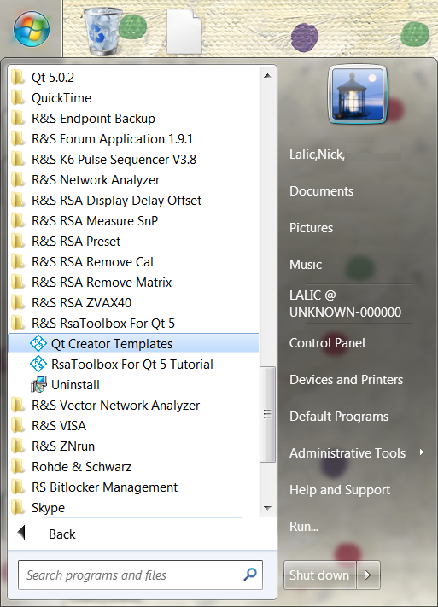

Installation
If you have not already done so, please install RsaToolbox For Qt 5.
The following tools are provided with RsaToolbox For Qt 5:
This tutorial ☺
Qt Creator templates (.zip file)
RSA Create Installer (not available via the Start Menu)

Slide 11
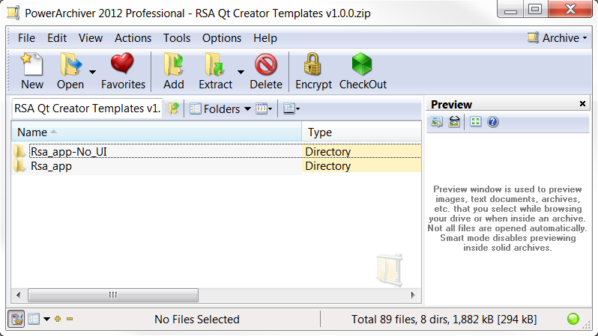
RSA Tools Setup
The first step to setting up RsaToolbox is to copy the application templates into Qt Creator
Find the Qt Creator template wizard directory on your machine. This should be very similar if not identical to: C:\Qt\Qt5.0.2\Tools\QtCreator\share\qtcreator\templates\wizards
Find the Qt Creator Templates .zip file (linked to from the Start Menu) and extract the contents (Rsa_app and Rsa_app-No_UI) to the Qt Creator template wizard directory shown above. It is important to copy the folders.

Slide 12
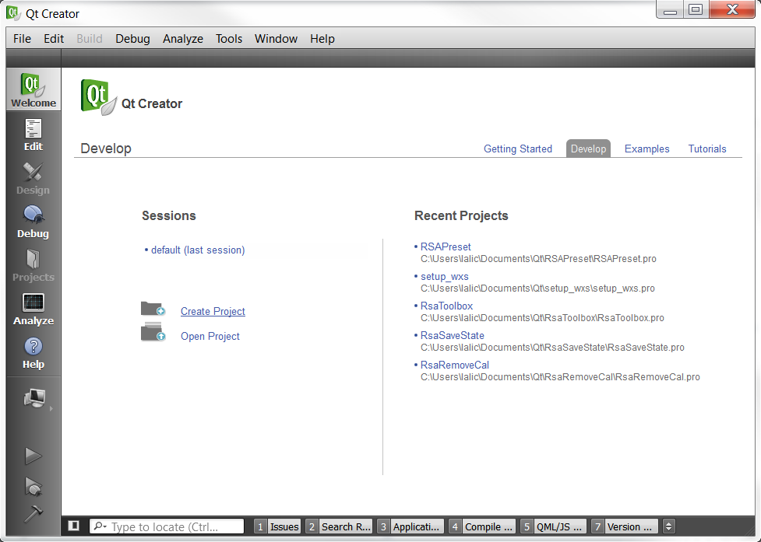
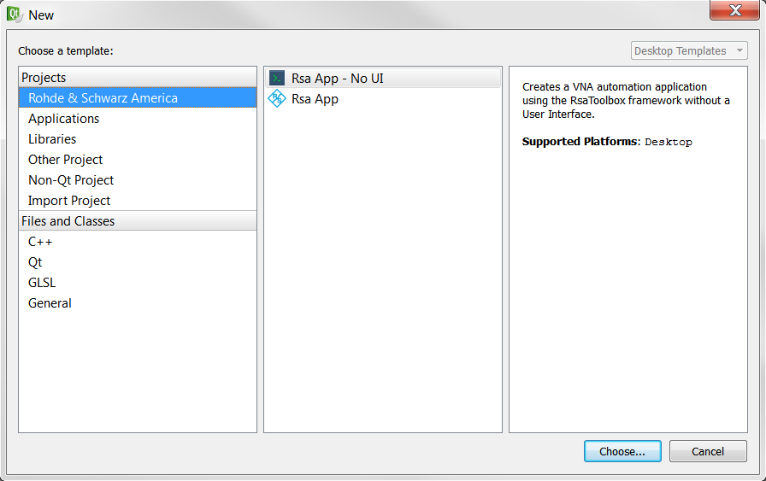
RSA Tools Setup
Confirm that the templates are installed to Qt Creator
Open Qt Creator – Found in the Start Menu under Qt 5.0.2 as of this tutorial
Click the Create Project link from the opening screen Alternatively you can click File → New File or Project
Confirm that the templates are available as a new project.

Slide 13
Licensing
Qt is available under two licenses: A commercial (paid) license from Nokia and the open source GNU LGPL v2.1 license. We will be using the LGPL license, which stipulates the following:
There are no restrictions on internal use
For applications deployed to a customer:
Qt libraries must be linked dynamically as external dlls (such that the executable is not considered a derivative work under LGPL)
The source code for Qt 5 must be available to the recipient
Any modifications to Qt must be released to the public as source code along with your application.
The source code for your application may remain closed if you wish
Your source code and executable, so long as they dynamically link to the Qt library, can be released under different licensing terms such as the “Rohde & Schwarz Inc. Terms and Conditions for Royalty-Free Products”

Slide 14
Licensing
The exact wording of the licensing terms for the Microsoft Visual C++ Runtime depends on the Microsoft product that they came with
In general:
Files listed in the redist.txt file in the root installation folder can be redistributed along with your application so long as the license for your application is at least as restricting as the Microsoft license you received them under.
The C++ runtime files msvcp100.dll and msvcr100.dll for Visual C++ 2010 are covered by redist.txt
We will be providing a Rohde & Schwarz license, as described below, that should provide sufficient coverage.
The RSA Create Installer tool automatically includes a copy of the “Rohde & Schwarz Inc. Terms and Conditions for Royalty-Free Products” with your application (see License.txt in the RsaToolbox installation folder).

Slide 15
Licensing
RSIB can also be distributed to customers under the “Rohde & Schwarz Inc. Terms and Conditions for Royalty-Free Products” license.
RSIB is also included automatically by RSA Create Installer
NI-VISA, properties of National Instruments, cannot be distributed with an application to a customer, as Rohde & Schwarz does not hold the proper deployment license. However, RsaToolbox will work with NI-VISA when provided by the end-user.

Slide 16
Our First App
“How do I get started?”

Slide 17
Delete Correction Data
Problem:
Recently a customer needed to be able to save VNA settings to a Recall Set file. These Recall Set files would then be distributed to a pool of VNAs in a production environment with several technicians. As it turns out, the correction data for each channel is saved along with the instrument settings in the Recall Set. When the Recall Set is loaded on another instrument the instrument then appears to be calibrated even though calibration data is not valid. A technician, therefore, may assume that the instrument is calibrated and perform inaccurate measurements.
We can meet the customers needs by deleting correction data from each channel BEFORE saving the Recall Set. Unfortunately the ZVA and ZNB both do not provide this functionality. Let’s write an application using RsaToolbox to get around this.

Slide 18
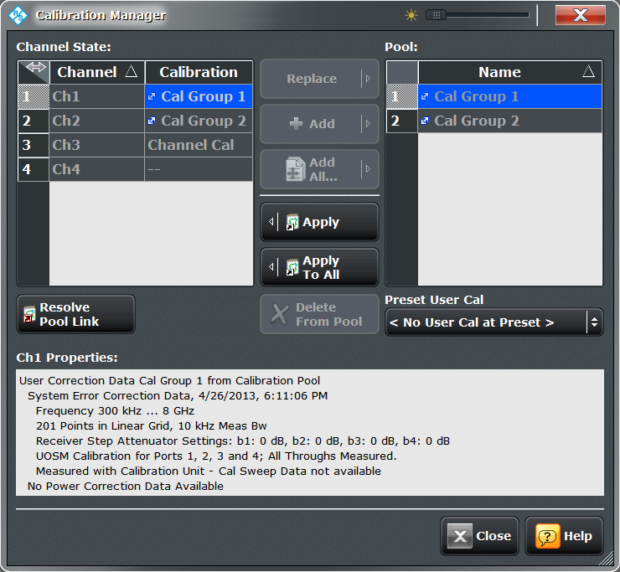
Delete Correction Data
The following is a screenshot of the ZNB Calibration Manager
As you can see there is no way to delete the correction data present in a channel. At best, we can “Resolve Pool Link”, which disconnects the channel from the Cal Group it is associated with, but the result is calibration data local to the channel itself, as seen in channel 3 (Ch3).

Slide 19
Delete Correction Data
Often customer problems such as these can be solved by creating a “macro”, or a small application installed on the VNA itself
These applications can be integrated into the “External Tools” menu of the instrument.
The functionality provided in the manual interface of the VNA does not exactly match that provided through the software interface. That is, Functions that do not exist manually will exist in software and vice versa.
We can use this fact to our advantage in this case.

Slide 20
Create a New Project
Let’s get back to creating a new RsaToolbox project:
Open Qt Creator
Click the Create Project link from the opening screen or you can also click File → New File or Project
Select the “Rsa App – No UI” as we will not need a user interface (UI)

Slide 21
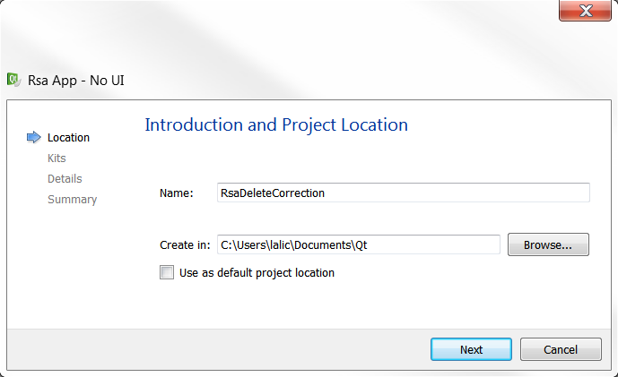
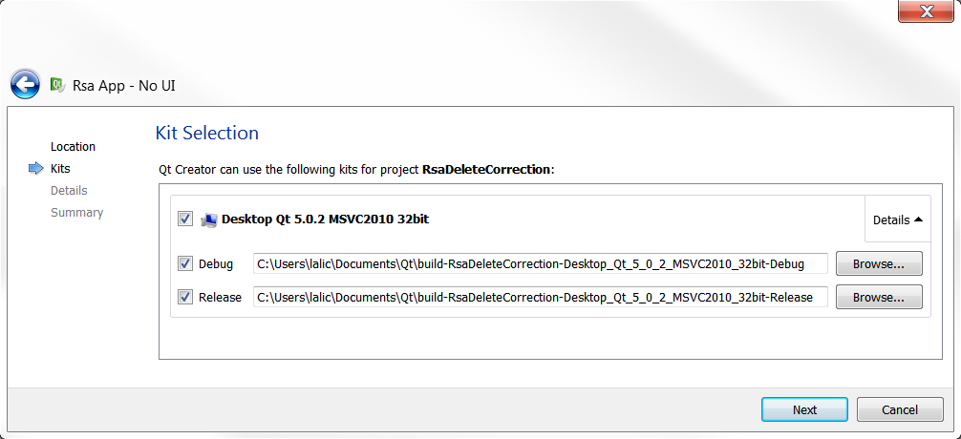
Create a New Project
Name your project RsaDeleteCorrection
Accept the default project location
Click Next
Accept the default “Kit”:
Desktop Application
Qt 5.0.2
Microsoft Visual C++ 2010
32-bit
Accept the default target directories
Click Next

Slide 22
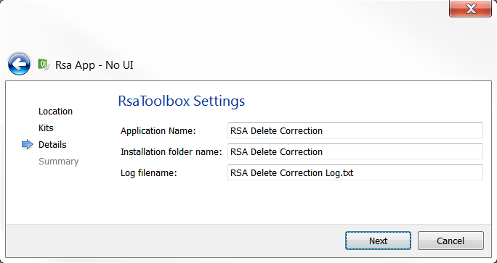
Create a New Project
Set Application Name to “RSA Delete Correction”
Set Installation folder Name to “RSA Delete Correction”
Set Log filename to “RSA Delete Correction Log.txt”
Click Next
Click Finish

Slide 23
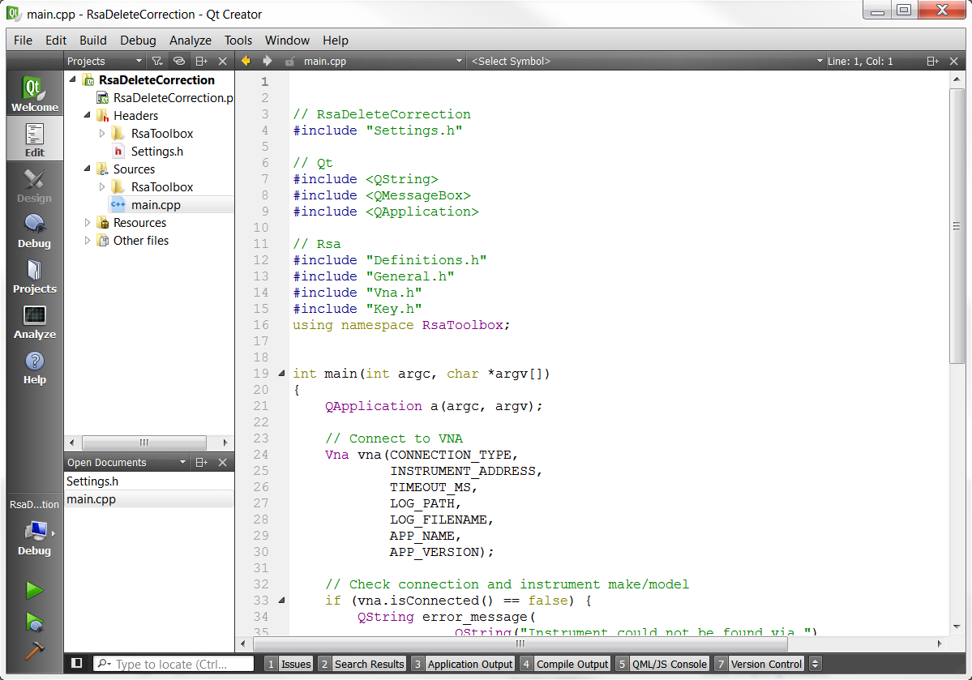
Create a New Project
At this point your project is created. You should see something similar to the following in Qt Creator

Slide 24
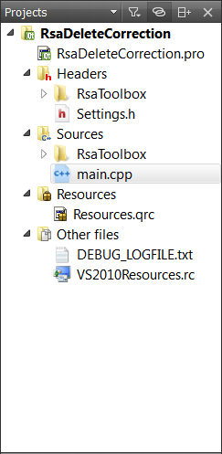
Project Components
Lets take a moment to discuss the various parts of this new project
In the Projects pane you will notice that several files have been added to your project
.pro files are Qt Creator Project files. They contain project information such as what type of project this is, what files to include and compiler settings.
The RsaToolbox folder contains the source code for RsaToolbox.
Settings.h is a C++ header file with settings for RsaToolbox applications
main.cpp contains the main function. Main is a function common to all C\C++ applications that contains the actual code for your application.

Slide 25
Project Components
Resources.qrc is a Qt Resource file that we are using to include a Rohde & Schwarz icon to be used with any Qt windows, such as error messages
VS2010Resources.rc is a similar resource file in a Microsoft Visual C++ format that specifies the icon to apply to the executable file after compiling.
DEBUG_LOGFILE.txt is just that; it is a log of all communication with the instrument as your commands run. This can be useful for debugging purposes. This file is written to when your project is in debug mode. In release mode, the log file is written to the installation directory instead.

Slide 26
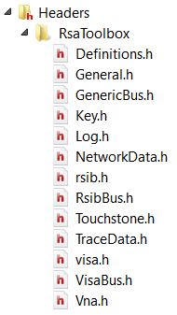
Project Components
RsaToolbox consists of the following:
Definitions.h contains a number of enumerations for describing the VNA settings and data format
General.h contains general-purpose functions, for example the ToString() function converts an enumerator to a human readable QString format.
NetworkData.h and TraceData.h are simple classes that hold measurement data and properties for S-Parameter networks and traces, respectively
Touchstone.h contains Read/Write functions for Touchstone (.sNp) Version 1.0 files.
Key.h contains a Key template class for reading and writing long-term application settings to binary files
Vna.h contains the Vna class which allows you to connect to and control an instrument.

Slide 27
Project Components
The rest of the header and source files of RsaToolbox work behind the scenes as far as application development is concerned. You do not need to understand them unless you want to modify or contribute to RsaToolbox.

Slide 28
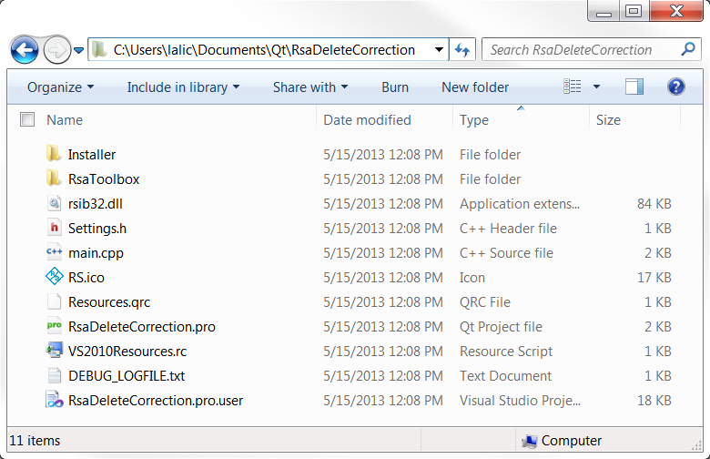
Project Components
If you navigate to the RsaDeleteCorrection project folder you will find all of the files previously mentioned plus a few more.
.pro.user files contain additional Qt Project settings specific to your computer.
Rsib32.dll contains the RSIB library, to be deployed with our application
The Installer folder contains additional files we will use later on to create a Windows installer for our application.
RsaToolbox contains the actual RsaToolbox code, including C++ headers and source files.

Slide 29
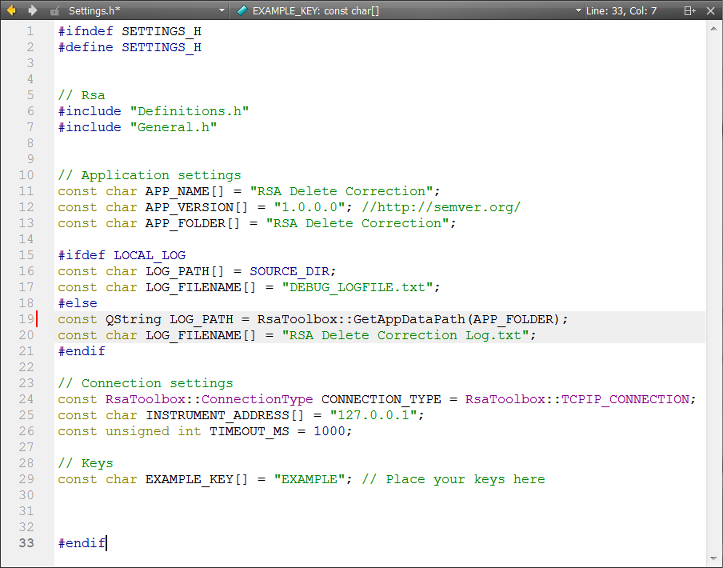
Project Components
Let’s move back to Qt Creator
Double-click Settings.h in the Project pane to open it.
In addition to the information we provided to create this project, Settings.h contains a few additional settings such as the application version and instrument connection information.
These settings are summarized in a header file for convenience, but can be defined elsewhere.
We will leave them as-is for now.

Slide 30
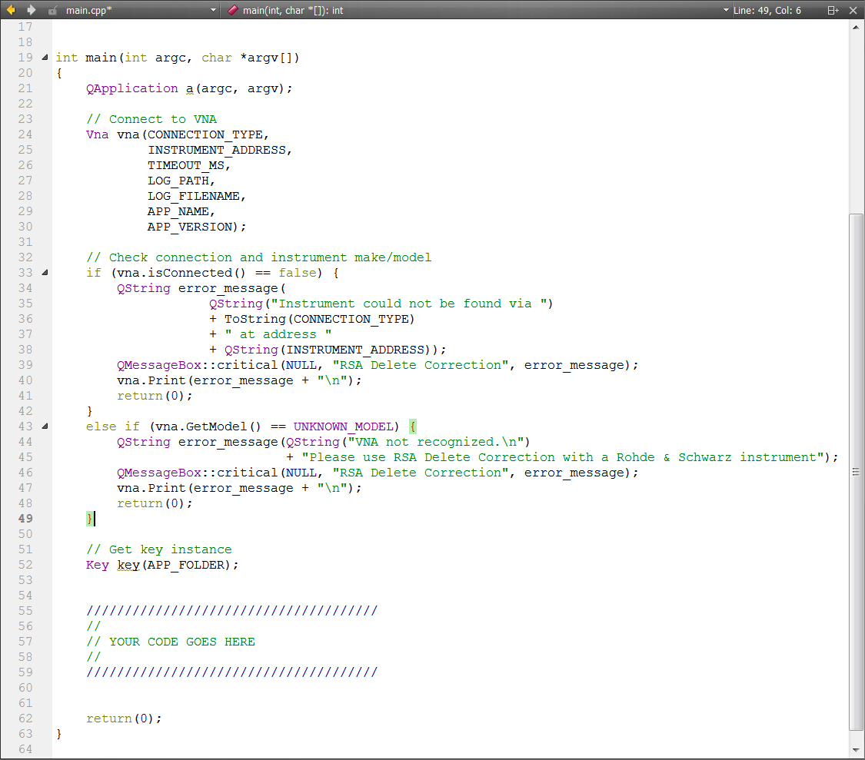
Project Components
Now open main.cpp.
Let’s focus on the contents of the main function for now
This code can be broken down into parts:
Connect to the VNA
Check connection status
Check VNA make/model
Create Key instance
// YOUR CODE GOES HERE

Slide 31
Vna Class
The Vna class connects to and controls an R&S VNA
The Vna constructor requires several arguments:
enum ConnectionType (TCPIP_CONNECTION or GPIB_CONNECTION)
QString instrument_address (such as “127.0.0.1” for a local TCPIP connection)
unsigned int timeout_ms, the time in milliseconds before instrument communication times out
QString log_path, the application’s path to the log file when released
QString Log file name
QString Application name
QString Application version
The parameters used here, as defined in Settings.h, default to a local TCPIP connection (for apps running on-instrument).
These parameters can be changed to meet your requirements.

Slide 32
Vna Class
The Vna function isConnected() returns true or false, indicating whether or not an instrument was found.
The Vna function GetModel() returns an enumerator as defined in Definitions.h, corresponding to the make/model of the instrument.
Enum VnaModel has the following possible values:
ZVA_MODEL
ZVB_MODEL
ZVH_MODEL
ZVL_MODEL
ZVT_MODEL
ZNB_MODEL
ZNC_MODEL
UNKNOWN_MODEL
These if/else statements display an error dialog if an instrument is not found or that instrument is not an R&S VNA model. The error is also printed to the log file

Slide 33
Deleting Corrections
Let’s skip the Key declaration for now. We will use it in Part 2 of this tutorial.
Despite the fact that you cannot create an empty Cal Group (no correction data) manually via the instrument interface, you CAN do it in software
If you then apply this empty Cal Group to a channel you effectively wipe out any existing correction data, deleting corrections from the channel
If we do this to each channel we can delete all the applied correction data from the instrument settings.
Saving the Recall Set will create a calibration-free file.

Slide 34
Vna Class
We will use the following Vna class functions to do this:
Reset()
CreateSet(QString set_name)
CloseSet(QString set_name)
QVector<unsigned int> GetChannels()
Channel(unsigned int channel)::SaveCalGroup(QString cal_file)
Channel(unsigned int channel)::SetCalGroup(QString cal_file)
The Vna::Channel(unsigned int channel) interface provides channel functionality
Similarly, the following interfaces for traces and diagrams are provided:
Vna::Trace(QString trace_name)
Vna::Diagram(unsigned int diagram)
Many other functions exist. They are defined in Vna.h
Note: RsaToolbox is currently in progress. Documentation does not yet exist, other than this tutorial. Please check Vna.h for more information.

Slide 35
Deleting Corrections
In order to simplify this example, let’s make some basic assumptions about the state of the instrument
No User Preset is defined
No Default Calibration on Preset is defined
Only one Recall Set is active
Our first step is to create a so-called “empty” Cal Group, as follows:
Create a temporary Recall Set with factory default settings (no calibration)
Save the calibration data (there is none) to a Cal Group.
Close this Recall Set, returning the instrument to its previous state

Slide 36
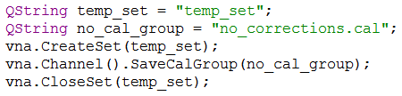
Deleting Corrections
Place the following code snippet, which does does just that, into main.cpp in place of the // YOUR CODE GOES HERE section.
Note that a call to Channel() with no argument defaults to channel 1

Slide 37
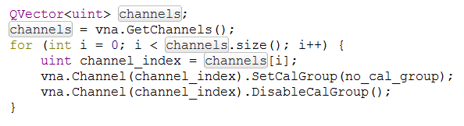
Deleting Corrections
Now that we have created our “no_corrections.cal” Cal Group, we can apply it to each active channel.
Call GetChannels() to get a Qvector list of active channels
For each channel, call SetCalGroup(“no_corrections.cal”) to effectively delete any correction data
Disassociate the channel from the Cal Group by calling DisableCalGroup()
Add the following code to main.cpp to do this:

Slide 38
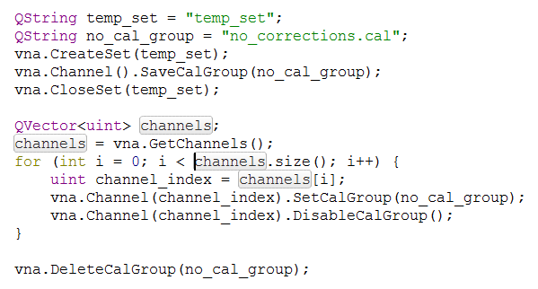
Deleting Corrections
To clean up, let’s delete the Cal Group that we created with the DeleteCalGroup() command.
After adding this, we are left with the following code for our simple application:

Slide 39
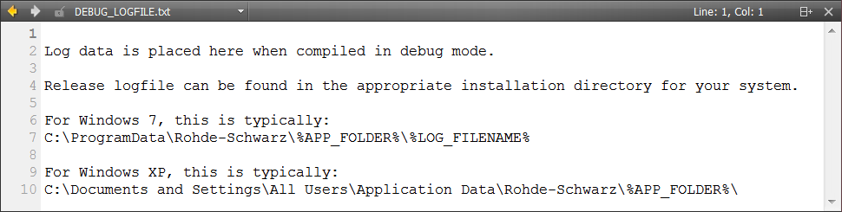
Compiling and Running
Before we compile, let’s take a look at the current contents of DEBUG_LOGFILE.txt:
Right now it contains a reminder of the location of the log file once your application is compiled in Release mode. This is the location of your log file when your application is deployed.
After we compile our application in debug mode and run it, this text will be replaced with information about our application, the instrument and any commands sent to it.

Slide 40

Compiling and Running
Click File → Close “DEBUG_LOGFILE.txt” to close the log file.
To compile and run your application in debug mode:
Confirm that Qt Creator is set to “Debug” by referencing the bottom-left panel of Qt Creator. If it instead says “Release” for some reason, click the computer icon to change it back to Debug
Click the big green play icon to compile and run.

Slide 41
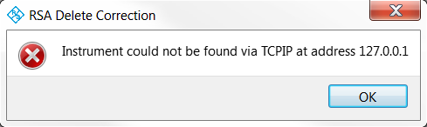
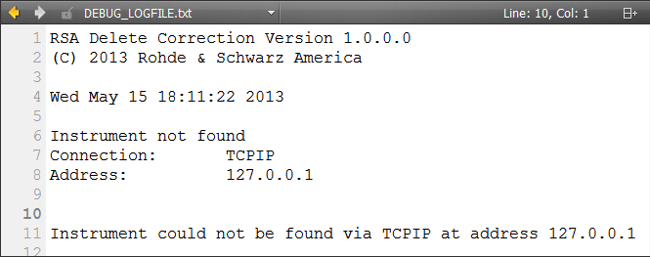
Compiling and Running
If you do not have a VNA emulator running on your development machine, you will get the following dialog and a mostly empty debug log file.

Slide 42
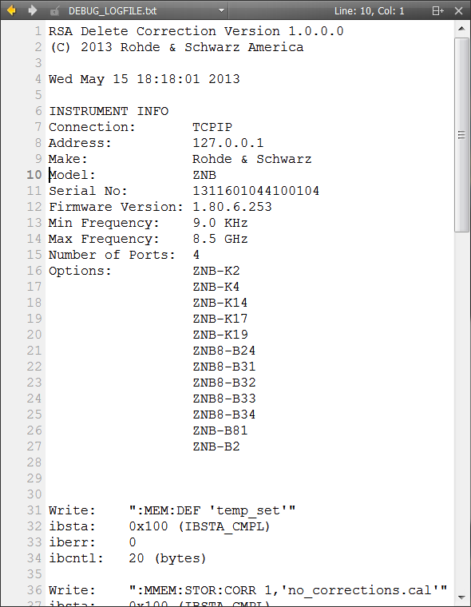
Compiling and Running
I happen to have a ZNB emulator running on my development machine. Here is an example of a filled out log file.
The application name and version is listed along with a time stamp and information about the instrument
If the instrument is not from R&S the log file will simply contain the identification string of the instrument
Following the log file header, you will see a list of every SCPI command or data transfer and the status codes of the instrument bus.

Slide 43
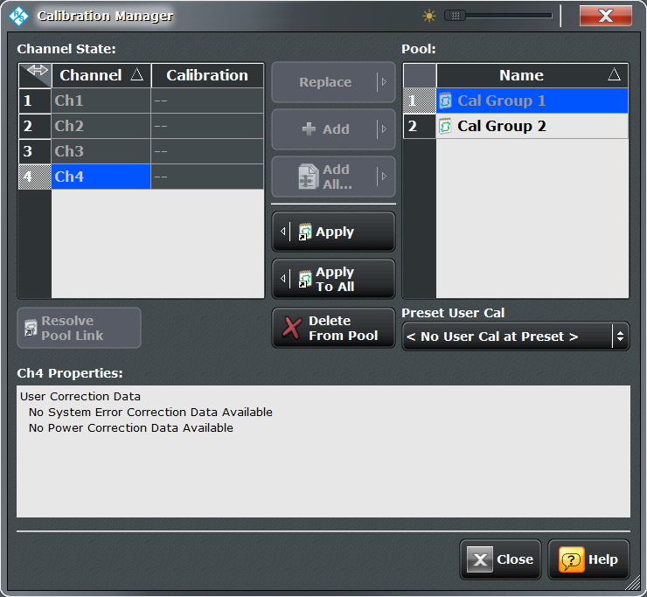
Compiling and Running
You can also see in Calibration Manager that the channel correction data has been deleted after running our application:

Slide 44
Creating an Installer
At this point, with our application compiling successfully, we can create an installer
To help you navigate the convoluted world of Windows Installer XML (WiX), I have created a tool, RSA Create Installer, to compliment projects created with these templates
RSA Create Installer processes a WiX template named Product.wxs found in the Installer folder of your project.
RSA Create Installer is run from Qt Creator itself as an external tool.
We will now set up Qt Creator to use it.

Slide 45
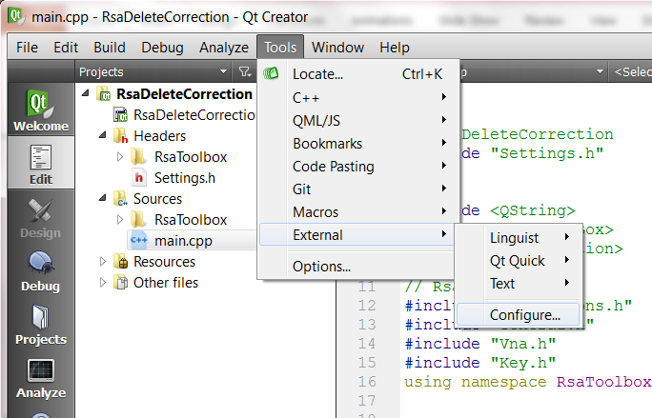
RSA Create Installer Setup
Click Tools → External → Configure to access the tool configuration menu

Slide 46
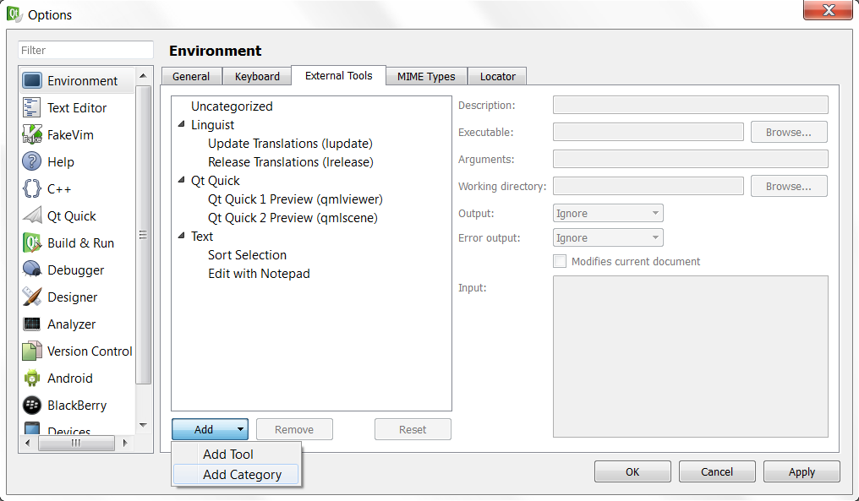
RSA Create Installer Setup
Click the Add button, then select Add Category
Name this new category “Rohde-Schwarz”

Slide 47
RSA Create Installer Setup
With “Rohde-Schwarz” highlighted, once again click the Add button, then click Add Tool
Name the tool “Create Installer” and give it the following settings:
Description: “This tool creates an installer for an RsaToolbox application”
Executable Path: This will depend on the installation location of RsaToolbox For Qt 5. On my Windows 7 64-bit development machine, it is located at: C:\Program Files (x86)\Rohde-Schwarz\RsaToolbox For Qt 5\RSA Create Installer\ RSA Create Installer 1.0.0.0.exe
Arguments: RSA Create Installer needs the current project’s build path to be able to find your executable. Click the Arguments text edit field, then click the Variables icon on the right. Double-click “CurrentProject:BuildPath” and exit. The Argument field should now contain “%{CurrentProject:BuildPath}”
Working Directory: Similarly, click the Variables icon and choose CurrentProject:FilePath, then append the text “/Installer” to the end. The Working directory field should now read “%{CurrentProject:Path}\Installer”

Slide 48
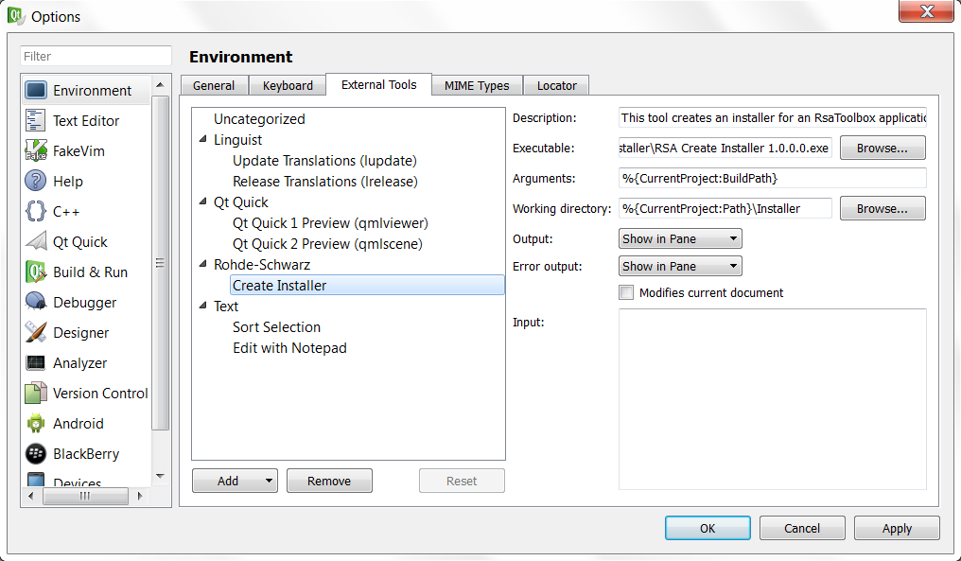
RSA Create Installer Setup
The result should look something like this:

Slide 49
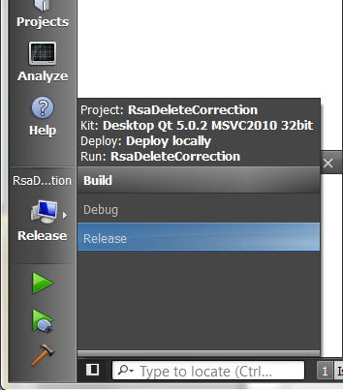
RSA Create Installer Setup
Click Ok to accept these changes and return to your project.
To use Create Installer, we must first put our project into Release mode and compile.
To do this, Click the computer icon in the bottom-left to access the build options.
Select Release mode to build with Release settings.
Compiling in debug mode and deploying your app with Release dlls will cause your program to crash. To prevent this, RSA Create Installer requires your project to be set to Release mode before you run it.
From the menu select Build then click Rebuild All.

Slide 50
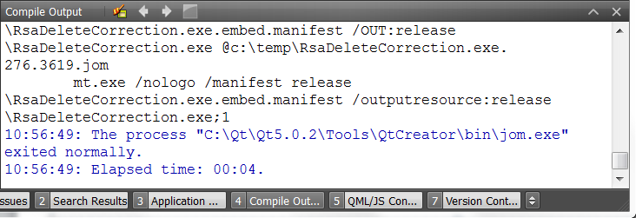
RSA Create Installer Setup
You can confirm that your application was built successfully by checking the Compile Output tab in the bottom-right.
You are now ready to run the RSA Create Installer tool by clicking Tools → External → Rohde-Schwarz → Create Installer

Slide 51
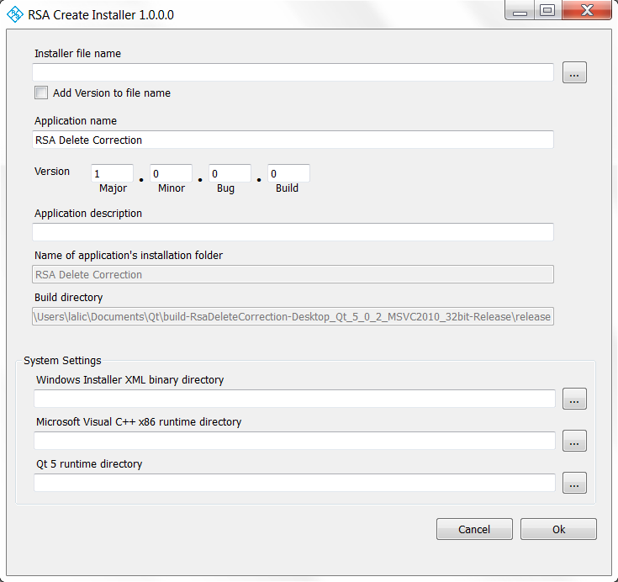
RSA Create Installer Setup
You should see a screen like this:

Slide 52
RSA Create Installer Setup
Create Installer has the following settings:
Installer File name
Application Name
Version
Application Description
Create Installer also redisplays:
The Application Installation Folder
The project’s Build Directory
Note that the Installation Folder is specified when the project is created. The generated project depends on it, and so it is not changeable.
These settings are remembered on a per-project basis.

Slide 53
RSA Create Installer Setup
Use the following settings:
Installer File name: “RSA Delete Correction” in the Installer folder
Check the Add version to file name checkbox
Application Name: “RSA Delete Correction”
Version: 1.0.0.0
Application Description: “Deletes all correction data from the active Recall Set”
Warning: While these settings are in part the same as those found in Settings.h, it is important to remember that they are specified separately in the Create Installer tool. As such, you will want to make sure that you coordinate any changes you make with Settings.h. Failing to do so will create an application with different names and versions specified in the app itself and the log file, compared to the installer and Windows Registry.

Slide 54
RSA Create Installer Setup
There are some additional system-level settings that point RSA Create Installer to the resources it needs.
These directories are set across all RsaToolbox projects and only need to be specified once.
They can be changed at any time to reflect any updates or system changes.
System Settings include:
The WiX Binary Directory
Visual C++ x86 Runtime Directory
Qt 5 Runtime Directory

Slide 55
RSA Create Installer Setup
The WiX Binary Directory
RSA Create Installer uses the WiX toolset to generate your installer. Specifically it is looking for the candle.exe compiler and light.exe linker. On a Windows 7 64-bit system, these are usually found in: C:\Program Files (x86)\WiX Toolset v3.7\bin
Visual C++ x86 Runtime Directory
Your installer will the C\C++ Runtime redistributables needed to run your application. Specifically, we need the msvcp100.dll and msvcr100.dll files. Using Visual Studio 2010 on Windows 7 64-bit, they are usually found here: C:\Program Files (x86)\Microsoft Visual Studio 10.0\VC\redist\x86\Microsoft.VC100.CRT

Slide 56
RSA Create Installer Setup
Qt 5 Runtime Directory
We need to deploy a myriad of Runtime files associated with Qt 5:
Qt5Core.dll
Qt5Gui.dll
Qt5Widgets.dll
D3DCompiler_43.dll
Icudt49.dll
Icuin49.dll
Icuuc49.dll
libEGL.dll
libGLESv2.dll
These files are usually located at a directory similar to: C:\Qt\Qt5.0.2\5.0.2\msvc2010\bin
One additional file, qwindows.dll, is needed for Windows applications. This file can be found relative to the rest by RSA Create Installer.

Slide 57
RSA Create Installer Setup
If you have not already done so, click the browse buttons to locate the WiX Toolset, Visual C++ Runtime and the Qt 5 Runtime.
RSA Create Installer will attempt to display the default locations for you. If it cannot find the files you will have to navigate to them manually.
As previously mentioned, you only have to do this once per system. RSA Create Installer will remember these settings for subsequent uses.

Slide 58
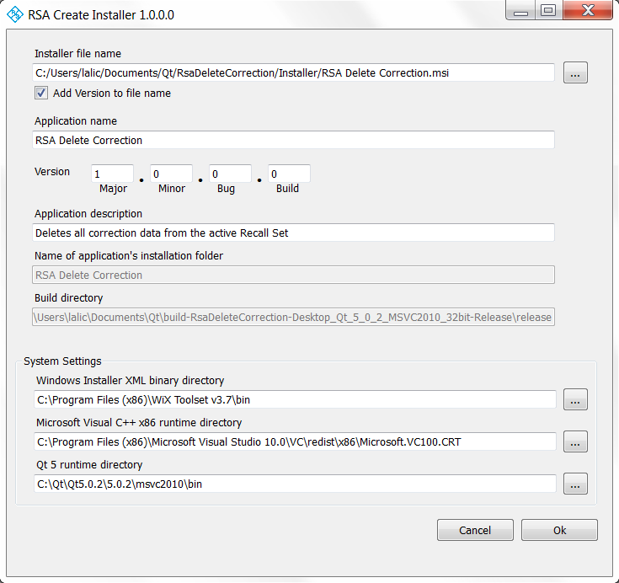
RSA Create Installer Setup
At this point your installer settings should look similar to this:

Slide 59
RSA Create Installer Setup
Click Ok to accept these settings and create a Windows Installer
If all goes well the status bar at the bottom of the window should display the message “Compiling…” and then “Linking… This may take some time”.
The WiX linking process, even for simple applications like this, can take as long as 45 seconds. Please be patient.
When WiX is finished RSA Create Installer will show you a dialog and then exit.
Navigate to the project’s Installer folder and you should find your installer. It will be named “RSA Delete Correction 1.0.0.0.msi”, per our request. Notice that the version number “1.0.0.0” has been added for your convenience.
Our application can now be deployed to any Rohde & Schwarz VNA!
The log file for your deployed application can be found at: C:\Documents and Settings\All Users\Application Data\Rohde-Schwarz\RSA Delete Correction\ for a ZVX VNA running Windows XP, and on a ZNB: C:\ProgramData\Rohde-Schwarz\RSA Delete Correction\

Slide 62
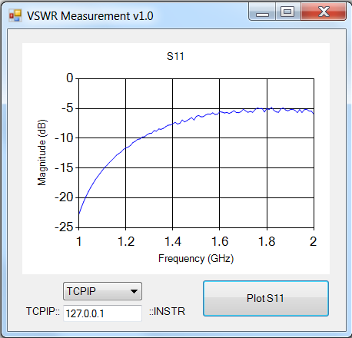
Instruction
With text
Bulletpoints
And a graphic

Slide 63
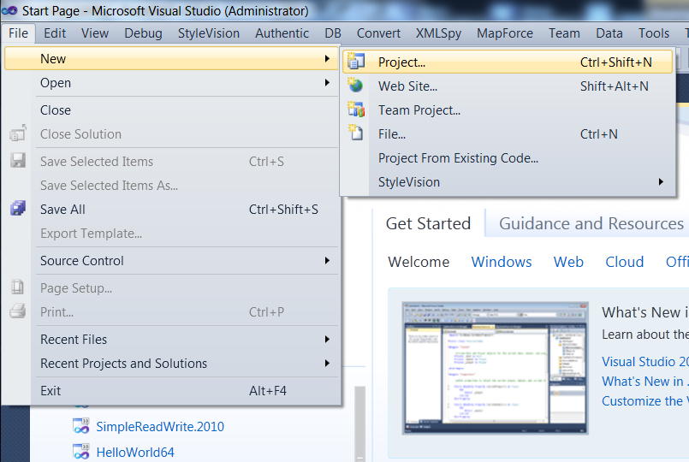
Windows Form Template
Direction #1 with graphic
1

Slide 64
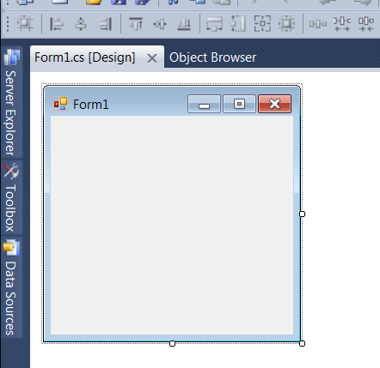
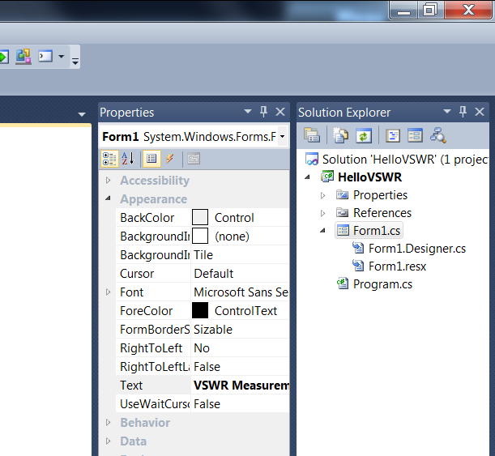
Design the GUI
Direction #4 + Graphic
Second column…
And Direction #5 + Graphic
4
5

Slide 65
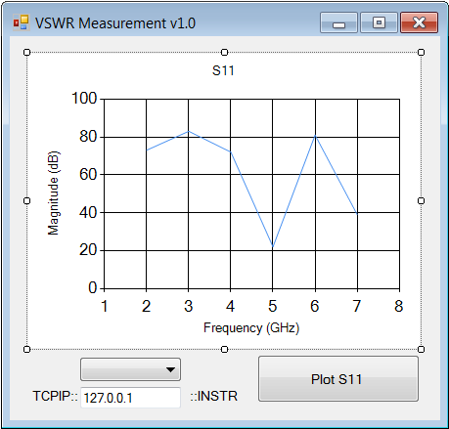
Design the GUI
10
Button
(Name): plotButton
Text: Plot S11
ComboBox
(Name): commTypeComboBox
DropDownStyle: DropDownList
Items: TCPIP:: GPIB::
Label
(Name): commTypeLabel
Text: TCPIP::
TextBox
(Name): addressTextBox
Text: 127.0.0.1
Label
(Name): instrLabel
Text: ::INSTR
Lots of directions, numbered, with graphic
11
12
13
14
11
10
12
13
14

Slide 66
Additional References
Installation:
Qt 5
Visual Studio 2010 Express
Windows Installer XML (WiX) Toolset
Licensing
Qt 5: GNU Lesser General Public License (LGPL) v2.1
Find End User License Terms for Microsoft Software

